Slide 1

WELCOME
We are waiting a few minutes for more individuals to join. We will start promptly at 09:10.
South Africa Works because of Public Works

Slide 2
Annual Financial Statements Inputs 2022/2023
South Africa Works because of Public Works

Slide 3
AGENDA
Activity | Branch/Unit
Housekeeping and Welcome | All
Background and Context | All
Day-to-day Maintenance Example | FM/Finance/SCM
Link to audit disclaimer | All
Day-to-day Maintenance Financial Reporting | FM/Finance/SCM
General Guidelines and Questions | All
Closure | All

Slide 4

Housekeeping and Welcome

Slide 5




HOUSEKEEPING
Feel free to ask questions or make comments in the chat, Kamogelo will note them and we will go through them individually at the end of every training section
Please mute yourself unless you are acknowledged and requested to speak
If you would like to be acknowledged to raise a question or provide a comment, please raise your hand
Please turn your video off

Slide 6

1. BACKGROUND & CONTEXT

Slide 7
BACKGROUND AND CONTEXT
AFS provide information about the results of operations, financial position, and cash flows of an organisation.
PMTE received a disclaimer of audit opinion from AGSA for 2021/2022 AFS audit.
To clear the disclaimer - requires inputs and assistance from all units.
Line Functions and regions to provide additional inputs, via workbooks, to properly account for full effect of all transactions as per GRAP (Generally Recognised Accounting Practice)
Accrual accounting knowledge is critical for clean and unqualified audit

Slide 8

2. Day-to-day Maintenance - Example

Slide 9




2.1 DAY-TO-DAY MAINTENANCE - Background
On 31 March 2023, we need to calculate a total value owed to our suppliers for D2D Maintenance services received throughout the year that have not been paid for as at 31 March 2023. WORK PAYMENT
Depending on the supporting documentation we have available to support these values, we either have to classify them as:
Accruals; or
Provisions in the Statement of Financial Position.
Liability
where we are CERTAIN OF
Timing AND Amount
Liability
where we are CERTAIN of either
Timing, OR
Amount

Slide 10
In the following example: All characters appearing in this work are fictitious. Any resemblance to real persons is purely coincidental. This is merely an example used to explain the thinking process used to create day-to-day maintenance provisions and accruals.

Slide 11
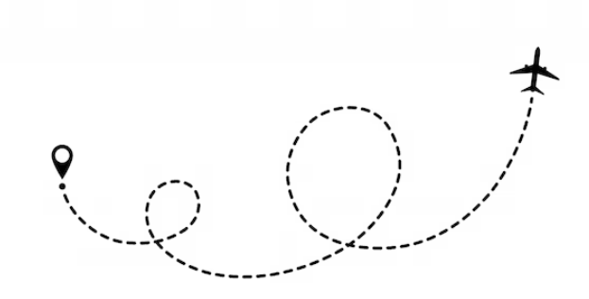
2.1 DAY-TO-DAY MAINTENANCE - EXAMPLE
I have a friend, Khaya – who has a full-time job as a an engineer, but over the past few years she has started to pursue options on creating additional income streams as she really wants to increase her travels, but her salary is not sufficient in pursuing this dream on its own.
Khaya asked me to assist her in compiling a of AFS for her own personal financial use as she does not have a background or experience in financial reporting and she is of the opinion that this type of analysis would greatly assist her in getting control of her finances and to be able to track her progress of reaching her dreams of becoming a globetrotter.
Very eager to assist someone in such a bold step in improving their quality of life, I suggested we start off with the Statement of Financial Position (Balance Sheet) and look for the information we need to compile it.
The Statement of Financial Position is commonly used to assess the position of a business in terms of financial stability and potential risk. A typical statement is likely to include a snapshot of a business's: assets, liabilities and equity (what remains of assets after deducting liabilities).

Slide 12
2.1 DAY-TO-DAY MAINTENANCE - EXAMPLE
ASSETS
Less
Primary Residence
LIABILITIES
Equals
Mortgage loans for her home
EQUITY
Khaya’s Net financial worth
Office Building
Car
Cash in the bank
Car loan
Unpaid Maintenance Bills

Slide 13
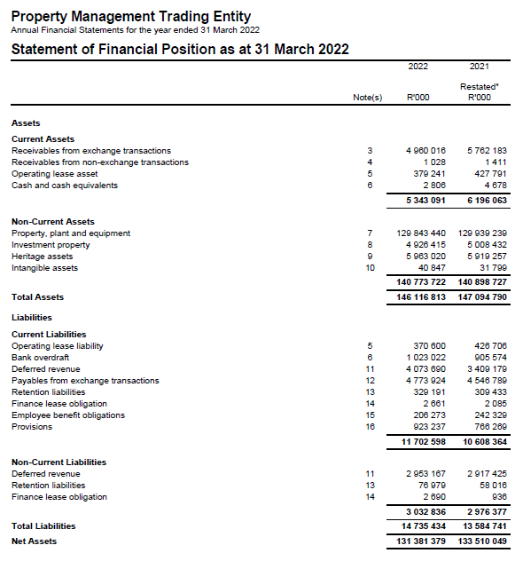

2.1 DAY-TO-DAY MAINTENANCE - EXAMPLE
Assets
Liabilities
Equity

Slide 14
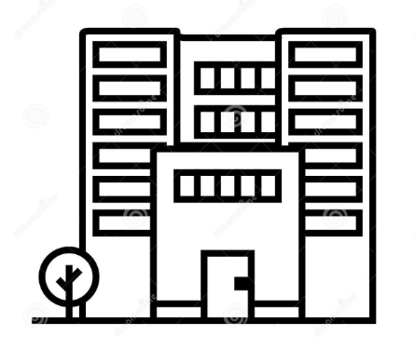
2.1 DAY-TO-DAY MAINTENANCE - EXAMPLE
Khaya purchased an office building a few years ago as an investment property. Until November 2022 she leased it to a lawyers office who used it as a call center and walk-in helpdesk.
However due to the COVID 19 pandemic, the lawyers could no longer continue operations as they had with the walk-in helpdesks and they also let the call center operate remotely from home and accordingly they had to give up the lease of the office building.
Khaya was tired of the volume of visitors to the office building, the maintenance it led to and the increased risks. So she has been in contact with an Architect friend of hers to take up occupation in the building. In order to satisfy this new tenant, Khaya had to do some upgrades and renovations on the building, including:
- Fixing one of the 3 toilets that hasn’t been in working order for many years
Repainting the offices
Upgrading the gardening and landscaping
Maintenance to be done to adhere to fire regulations which have not been done to date
Liability
where we are CERTAIN OF
Timing AND Amount

Slide 15
2.1 DAY-TO-DAY MAINTENANCE - EXAMPLE
COMPILING AFS FOR KHAYA AS AT 31 MARCH 2023:
 |  |  | R
Assets |  |  | 2 586 000
 | Home | 1 500 000
 | Office Building | 1 000 000
 | Car | 80 000
 | Cash in bank | 6 000
Liabilities |  |  | ??
 | Mortgage loan - Home | 650 000
 | Car loan | 15 000
 | Accruals - D2D Maintenance | ??
 | Provisions - D2D Maintenance | ??
Equity (Net Worth) |  |  | ??
Liability
where we are CERTAIN OF
Timing AND Amount

Slide 16
2.1 DAY-TO-DAY MAINTENANCE - EXAMPLE
As at 31 March 2023:
The repair of the toilet was completed, I contacted the service provider who gave me a job card signed on 10 March 2023 and an invoice to the value of R7,500.
The painting of the building was completed, the service provider provided me with a job card signed 12 March 2023, but could not provide me with an invoice yet. We did however calculate based on past experience that the average cost of this type of service and the volume of work is R22,000 for the entire building.
The upgrading of the landscaping has not entirely been completed yet. We do have a quote for the work done, but as the service provider is still in the process of completing the work, they could not provide me with a signed job card yet.
We could not get a hold of the service provider performing maintenance related to getting the building to the required standards of national fire regulations to confirm whether the work has been done or to provide us with a value of any work completed to date.
Liability
where we are CERTAIN OF
Timing AND Amount

Slide 17

2.1 DAY-TO-DAY MAINTENANCE - EXAMPLE
As at 31 March 2023:
Toilet Repair
Signed Job Card
Invoice
ACCRUAL AS AT YE
Painting of building
Signed Job Card
No Quote or Invoice
SPECIFIC PROVISIONS – AVERAGE PRICE AT YE
Fire Regulations
No Job Card
No indication of Value GENERAL PROVISION
Landscaping
No Job Card
Quote
YET – work not completed
NO ACCRUAL/GENERAL

Slide 18

2.1 DAY-TO-DAY MAINTENANCE - EXAMPLE
Liability
where we are CERTAIN OF
Timing AND Amount

Slide 19

3. DISCLAIMED OPINION
- MEANING AND IMPLICATIONS

Slide 20
DISCLAIMED AUDIT OPINION

Slide 21

DISCLAIMED AUDIT OPINION
Disclaimer of audit report paragraphs in 2021/2022 AFS
Payables from exchange transactions - Accrued expenses- Municipal services
Difference between recalculated amount by auditors and accrued amount in the workbook (Accuracy issue)
Payables from exchange transactions - Accrued expenses
Goods and services were received before year end, however the trading entity did not recognize the accrued expenses (Completeness issue)
PPE
Restatement could not be substantiated by supporting audit evidence (Limitation of scope)
Payables from exchange transactions - Accrued expenses- Leases
Difference between the recalculated balance and the accrued expenses (Completeness issue)

Slide 22

4. Day-to-day Maintenance: Financial Reporting

Slide 23
4.1 APPROACH TO ACCRUING/PROVIDING FOR D2D MAINTENANCE
Head Office retrieves reports from W4U and Archibus to indicate all logged calls
Head Office uses these reports to compile workbooks with relevant calls (as per W4U and Archibus) to be accrued for
Regions complete workbooks received from Head Office with all relevant information
Head Office reviews and consolidates completed workbooks to accruals and provisions and journalise the final values into SAGE and accordingly into the AFS
Liability
where we are CERTAIN OF
Timing AND Amount

Slide 24

4.1 APPROACH TO ACCRUING/PROVIDING FOR D2D MAINTENANCE
All calls are logged through 2 systems – Archibus and Worx4U
Statuses on Worx4U
Open
Call has been logged, supplier has not been assigned, work has not been completed and therefore no accrual can be created as the services have not been rendered.
In-Progress
Supplier has been assigned to the work, however work has not been completed yet and no accrual can be created as the services have not been rendered.
Completed
Work has been completed by the service provider, of which a reliable estimate of the value should be available and therefore an accrual/provision should be created for the value of the services rendered.
Closed
Payment has been made and call has been finalized.
Cancelled
Call has been cancelled.
Pending
Process of completing call has been stopped for the time being.
Liability
where we are CERTAIN OF
Timing AND Amount

Slide 25

4.1 APPROACH TO ACCRUING/PROVIDING FOR D2D MAINTENANCE
STATUSES ON ARCHIBUS:
On Archibus, there is also only one status which complies to the definition of accruals – COMPLETED status.
The rest of the statuses either indicate that
The case has been opened but work has not started
The work has started, but has not been completed yet
The work has been paid or cancelled, so no accrual remains as at 31 March 2023
Requested; Reviewed but on hold; Rejected; Approved; Assigned to Work Order
Issued and in Process; On hold for parts; On hold for access; On hold for labor; Stopped
Liability
where we are CERTAIN OF
Timing AND Amount
Closed; cancelled

Slide 26
4.1 APPROACH TO ACCRUING/PROVIDING FOR D2D MAINTENANCE
Process Description for D2D using Worx4U
On 31 March 2023, only the calls in COMPLETED status meet the definition of an accrual, these calls are all extracted and added to the final consolidated workbook distributed to regions.
Process Description for D2D using Archibus
As there are numerous issues in getting the statuses of calls correct as and when they change, there is no comfort that the statuses reflected against the calls on 31 March 2023 are indeed accurate. Accordingly, only the closed and cancelled calls are excluded from the listing which is extracted and then added to the final consolidated workbook distributed to regions.
Liability
where we are CERTAIN OF
Timing AND Amount

Slide 27
4.1 APPROACH TO ACCRUING/PROVIDING FOR D2D MAINTENANCE
Process Description for the rest of the process
The consolidated workbooks reflecting all calls described in the prior slide are then distributed to the various regions.
On the workbook the regions then indicate the date of completion (as per service provider sign off date on the job card) and the value (as per invoice/quote) allocated to each call.
The regions adds or removes any calls which had incorrect statuses at 31 March 2023 to reflect complete and accurate accrual totals as at reporting date.
Based on the supporting documentation indicated, Head Office then allocates the calls either to provisions or to accruals using the following matrix:
Liability
where we are CERTAIN OF
Timing AND Amount

Slide 28
4.2 APPROACH TO ACCRUING/PROVIDING FOR D2D MAINTENANCE: DECISION MATRIX
Decision Matrix – Classification of D2D
Liability
where we are CERTAIN OF
Timing AND Amount

Slide 29
4.2 APPROACH TO ACCRUING/PROVIDING FOR D2D MAINTENANCE: FINALISATION
Finalisation of the process
After the REVIEWED workbooks have been submitted to Head Office and all of Head Office’s review queries have also been attended to and finalised, all calls that could not be classified as an Accrual/Specific Provision are included in the calculation of a General Provision.
General Provisions uses:
An average value for each type of call and an
average time of completion (both based on past performance) and then includes all calls that exceed the average time of completion at the average value of such a type of call. This calculation is done at Head Office.
Once all the values have been determined, journals are passed at Head Office to include these values in the financial statements and reconciliations are performed in order to comply with the financial statement disclosure requirements.
Liability
where we are CERTAIN OF
Timing AND Amount

Slide 30

4.4 APPROACH TO ACCRUING/PROVIDING FOR D2D MAINTENANCE: WORKBOOK
Refer to Day-to-day Maintenance
Workbook and Final Review Document
Liability
where we are CERTAIN OF
Timing AND Amount

Slide 31

5. General Guidelines

Slide 32
5.1 GENERAL GUIDELINES – WORKBOOK FINALISATION
GENERAL GUIDELINES – WORKBOOKS
Review workbooks before submission to Head Office
Ensure that columns requiring dates are filled in date format
Ensure amounts are entered in numeric format
Please make sure all cancelled calls reflect a status of being cancelled
Review high values in the workbooks for existence
Follow up on all incomplete line items
Ensure all accruals listed relate to the period ending before 31 March 2023
No Blank cells in workbooks; if not applicable type “N/A” or “R0.00”
All relevant line items to be supported by documentation and referenced for ease of use in the audit file to be kept at every region, reference numbers to be indicated on the relevant workbooks
No workbooks will be accepted by Head Office if the Review Declaration is not completed and signed off and submitted with the relevant workbooks.
A shortened review analysis will be sent out based on the workbooks completed. Please review this document too, as this document will be used to format workbooks to agree to the totals of the review document.
Liability
where we are CERTAIN OF
Timing AND Amount

Slide 33
5.2 GENERAL GUIDELINES – WORKBOOK STRATEGY
GENERAL GUIDELINES – DEADLINES
Issues relating to the quality of review of workbooks submitted
No review by finance of inputs prepared by line function due to the non-adherence to deadline dates
Numerous errors and follow ups required on workbooks
Date format and dates after reporting period
Duplicate entries
Incomplete information
Issues relating to adherence to deadline dates
Late submission of workbooks impacts consolidation and financial statements
Submission to AG required within 3 days of RFI or COFF
Liability
where we are CERTAIN OF
Timing AND Amount
CRITICAL:
Arrange adequate staff to compile and review workbooks within deadline dates

Slide 34
5.3 GENERAL GUIDELINES – WORKBOOK FEEDBACK
GENERAL GUIDELINES – AUDIT OPINION
Problem 1: Incompleteness (understatement)
Solution: Capture all transactions that meet the criteria
Problem 2: Inaccuracy
Solution: Ensure that what is captured agrees to the supporting documents (Rand values and classifications)
Problem 3: Lack of supporting documentation for amounts captured
Solution: Ensure that supporting documents are available timeously for all amounts captured
Problem 4: Overstatement
Solution: Ensure that only transactions that meet the criteria are included in the workbook.
Do write-off submissions for all suspense account transactions that are not recoverable
Liability
where we are CERTAIN OF
Timing AND Amount

Slide 35

5. QUESTIONS

Slide 36
THANK YOU
South Africa Works because of Public Works

